Slide 1
IE 534/CS 547
Deep Dive Project, Group 5 “Reynold”
Yulin Zhao(yulin6), Siqi Du(siqidu3), ShunTat Lam (stlam2), Huiqian Jing(hjing6)

Slide 2

Background & Problem Statement
In 2022, a major issue facing by common American is the gasoline price. The prices fluctuate up and down, bring tons of trouble for financial planning.
To break through the fog of gasoline price, our team aim to build a deep learning model that help to predict the gasoline price in the near future for family budget planners and policy makers.
In our model, we used the data from past 12 weeks, to predicate the percentage change of gasoline price in the future 4 weeks.
Dataset used: https://view.officeapps.live.com/op/view.aspx?src=https%3A%2F%2Fwww.eia.gov%2Fdnav%2Fpet%2Fxls%2FPET_MOVE_WKLY_DC_NUS-Z00_MBBLPD_W.xls&wdOrigin=BROWSELINK
https://view.officeapps.live.com/op/view.aspx?src=https%3A%2F%2Fwww.eia.gov%2Fdnav%2Fpet%2Fhist_xls%2FEMM_EPM0_PTE_NUS_DPGw.xls&wdOrigin=BROWSELINK
Current Slide is made by : ShunTat Lam

Slide 3
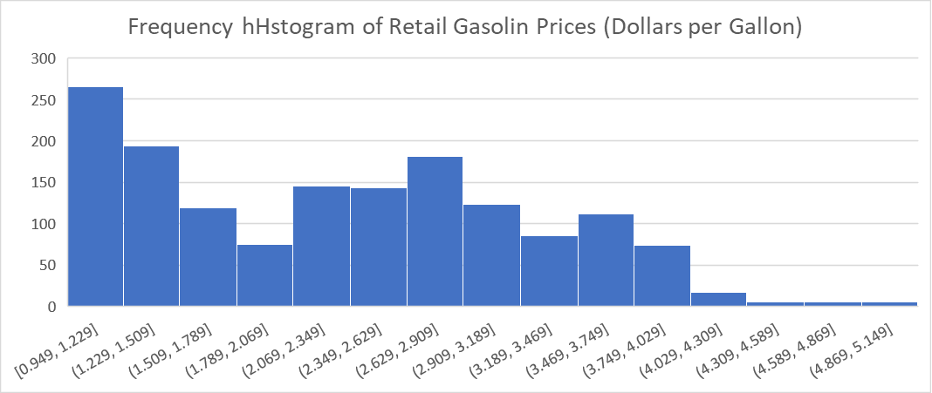
Data Description
Raw Dataset:
44 Features * 1660 Rows (Weeks) = 73,040 data points
Issue: uncountable missing data! Tons of non-value.
Price Dataset (Actual)
Max Price = 5.107 $/Gal.
Min Price = 0.949$/Gal.
Range = 4.158$/Gal.
Processed Dataset:
14 Features * 1542 Rows (Weeks) = 21,588 data points
All non-value data points removed.
Current Slide is made by : ShunTat Lam
Notes:
多少数据，

Slide 4
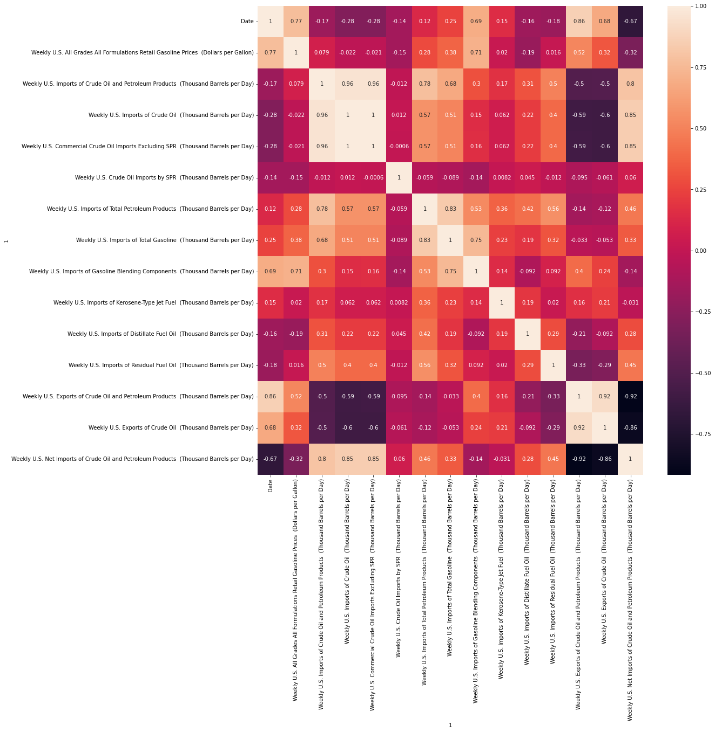
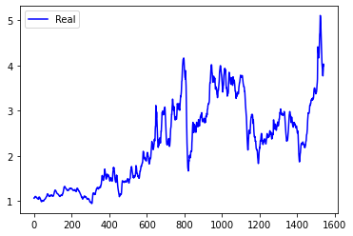
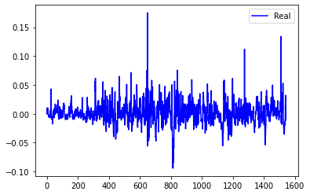
Exploratory Data Analysis
Data preprocessing
Convert original prices into the percentage change of the prices with respect to last week's
Actual Gasoline Prices versus Time
Price Change Percentage Versus Time
Heatmap of Features
Current Slide is made by : Huiqian Jing
Notes:
, we choose to include all features except the date

Slide 5
Baseline - Linear Regression
Linear regression is a linear approach for modelling the relationship between a scalar response and one or more explanatory variables
Input of our linear regression model:
12 * 14 = 1 * 168 matrix
Output of our linear regression model:
1 * 4 matrix
Current Slide is made by : Huiqian Jing
Notes:
fourteen features in the previous twelve weeks
, which are the price changes of oil in the next four weeks

Slide 6
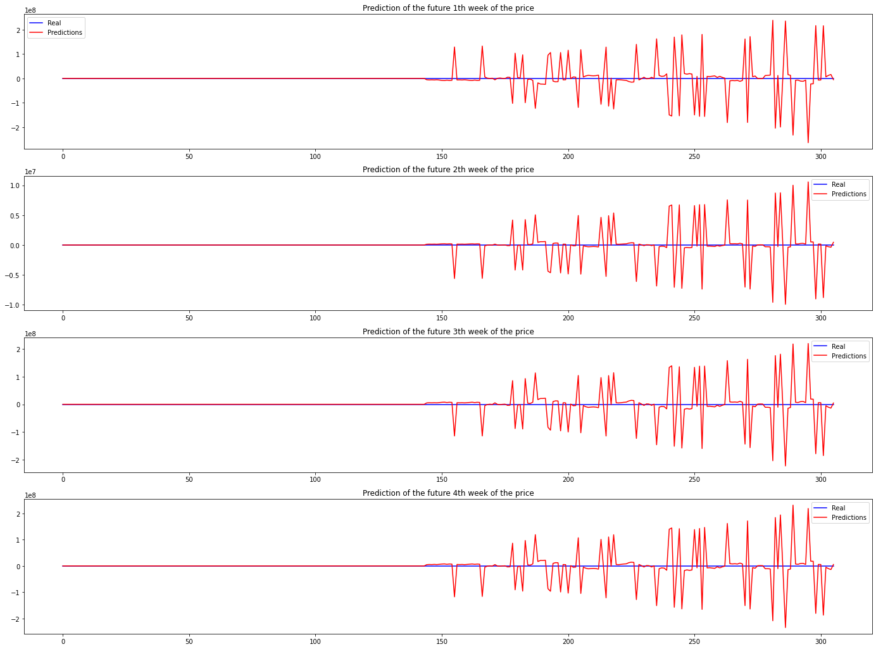
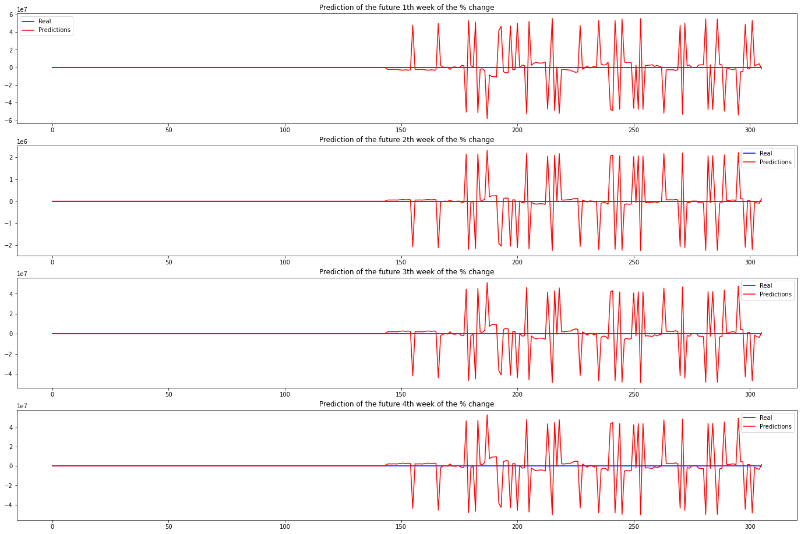
Predicted the real price changes in the following 4 weeks
Predicted the real prices in the following 4 weeks
Current Slide is made by : Huiqian Jing

Slide 7
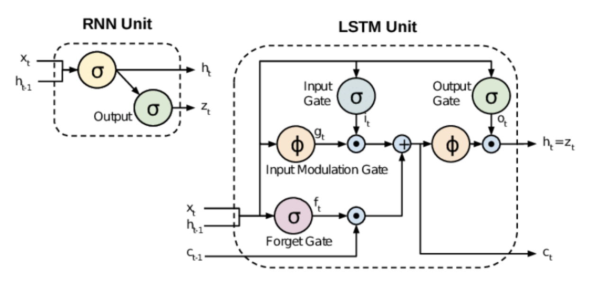
LSTM Model - Intro
Since our problem is a time series prediction problem, we implement long short-term memory (LSTM).
LSTM can handle the information in memory for the long period of time as compare to RNN.
Compared to RNN, LSTM replaces the ordinary recurrent node as a memory cell
The data feeding into the LSTM gates as illustrated in following figure.
Input shape: (1526, 12, 14)
Output shape: (1526, 4)
Current Slide is made by : Siqi Du
Notes:
we use 2 layers in this case, these layers with sigmoid activation functions compute the values of the input, forget, and output gates.
解释一下lstm对于rnn的改进，和上图说下lstm的gates
memory cell:(maintain information in memory for long periods of time)

Slide 8
Model Optimization - Model Structure
The initial model includes a LSTM layer (with 32 nodes and dropout rate = 0.2) and a feedforward layer to get outputs.
Model(
(lstm): LSTM(14, 32, num_layers=1, batch_first=True, dropout=0.2)
(fc): Linear(in_features=32, out_features=4, bias=True)
)
Test RMSE: 0.031
After testing several different structure, our best model structure includes 3 LSTM layers
(with 64 nodes and dropout rate = 0.3) and a feedforward layer to get outputs.
Model(
(lstm): LSTM(14, 64, num_layers=3, batch_first=True, dropout=0.3)
(fc): Linear(in_features=64, out_features=4, bias=True)
)
Test RMSE: 0.027
Current Slide is made by : Yulin Zhao

Slide 9
Model Optimization - Optimizer & Batchsize
Dataset Splitting: 60% Training Set, 20% Validation Set, 20% Testing Set
Batch Size Optimization
Optimizer | Optimizer Parameter | Batch Size | Early Stop Epoch | Train Loss | Valid Loss
Adam | lr = 0.001 | 16 | 23 | 3.42E-04 | 2.96E-04
Adam | lr = 0.001 | full | 20 | 1.01E-03 | 1.12E-03
Adam | lr = 0.001 | 1 | 60 | 3.18E-04 | 2.69E-04
Current Slide is made by : Siqi Du
Notes:
minibatch takes 16s, but online learning takes 5 min 42 seconds to execute.

Slide 10
Model Optimization - Optimizer & Batchsize
Dataset Splitting: 60% Training Set, 20% Validation Set, 20% Testing Set
Optimizer Parameter Optimization
Optimizer | Optimizer Parameter | Batch Size | Early Stop Epoch | Train Loss | Valid Loss
SGD | lr = 0.001, momentum = 0, weight_decay = 0.9 | 16 | NA | 3.97E-04 | 3.32E-04
Adam | lr = 0.001, weight_decay = 0.9 | 16 | 22 | 3.98E-04 | 3.32E-04
Adam | lr = 0.0001 | 16 | NA | 3.66E-04 | 3.03E-04
Current Slide is made by : Siqi Du
Notes:
For SGD optimizer, we also tried the learning rate = 0.1, 0.01, 0.001, and 0.0001. Speaking of the result, lr = 0.0001 is the best match. The others are either non-convergent or having bigger loss.
For SGD optimizer, we also tried weight decay = 0.8, 0.85, and 0.9. Speaking of the result, wd = 0.9 is the best match. The rest of them all generate bigger losses.
For SGD optimizer, we also tried momentum = 0, 0.2, 0.5, and 0.8. Speaking of the result, m = 0 is the best one having minimum loss.
The best loss gained from SGD is 3.31e-04
For Adam optimizer, we also tried the learning rate = 0.1, 0.01, 0.001, and 0.0001. Speaking of the result, lr = 0.001 gives the best result
For Adam optimizer, we also tried the weight decay = 0.8, 0.85 and 0.9. Speaking of the resultg, 0.9 is the best match
The best loss gained from Adam ( without changing batch size.etc) is 3.32e-04

Slide 11
Model Optimization - Optimizer & Batchsize
Dataset Splitting: 60% Training Set, 20% Validation Set, 20% Testing Set
Hyperparameter Optimization
Layer Number | Drop Out | Hidden Size | Optimizer | Batch Size | Early Stop Epoch | Train Loss | Valid Loss | Test Loss
2 | 0.2 | 64 | Adam, lr=0.0001 | 16 | 42 | 3.63E-04 | 3.21E-04 | \
3 | 0.2 | 32 | Adam, lr=0.0001 | 16 | \ | 3.64E-04 | 3.50E-04 | \
2 | 0.3 | 32 | Adam, lr=0.0001 | 16 | 52 | 3.98E-04 | 3.76E-04 | \
3 | 0.3 | 64 | Adam, lr=0.0001 | 16 | 96 | 3.45E-04 | 2.92E-04 | 1.86E-03
Current Slide is made by : Siqi Du

Slide 12
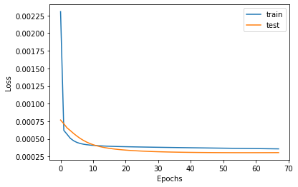
Results Comparison
For this regression task, we uses Root of mean square error (RMSE) as metrics to evaluate the results.
 | Linear Regression | LSTM
Overall | 13058150.30 | 0.027
1st Week Prediction | 18432413.31 | 0.020
2nd Week Prediction | 774771.53 | 0.041
3rd Week Prediction | 16206909.98 | 0.019
4th Week Prediction | 16818506.40 | 0.030
* Our prediction is future price % change of four weeks. We also calculate the RMSE for the 1st, 2nd, 3rd, 4th future week in our prediction.
The learning curve of LSTM Method
Current Slide is made by : Yulin Zhao

Slide 13
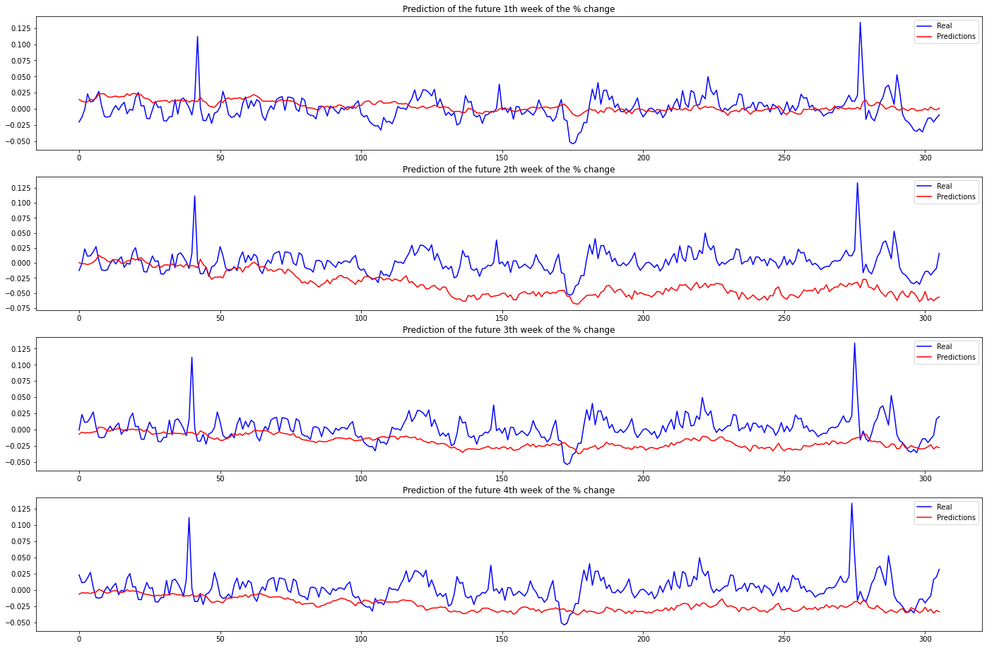
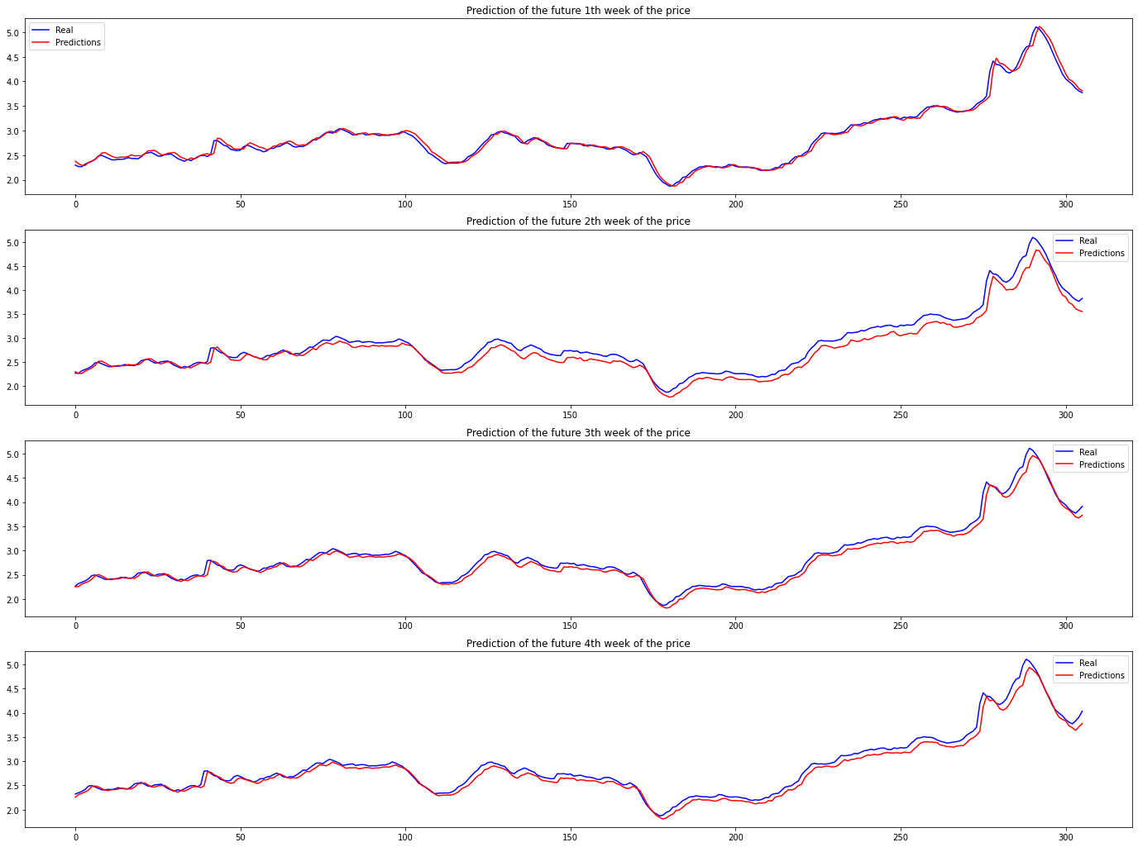
Predicted the real price changes in the following 4 weeks
Predicted the real prices in the following 4 weeks
Current Slide is made by : Yulin Zhao

Slide 14
Conclusion
Compared to our baseline (Linear Regression), our LSTM model achieves great performance on predicting the percentage change of gasoline price for the future four weeks.
However,
our predicted price has ‘one-day’ delay, compared to the real price
might be due to the overfitting issues
can be addressed by having more data (e.g. 1M+ rows)
Thus, although our model achieves great performance, it needs future work to be prepared to deploy to address the real-world problem.
Current Slide is made by : Yulin Zhao

Slide 15
Thanks for watching!

